Slide 1
Introduction to Python Programming
UCSD ECE Summer workshop course_0 = ['8-25-2015', '8-27-2015'] course_1 = ['9-02-2015', '9-03-2015']

Slide 2
Overview
Introduction
Python as a calculator
Basics
Variables
Types
Control flow
Functions
Data structures
Importing libraries
Practical example: image processing
Practical example: anagram detection

Slide 3
Introduction

Slide 4
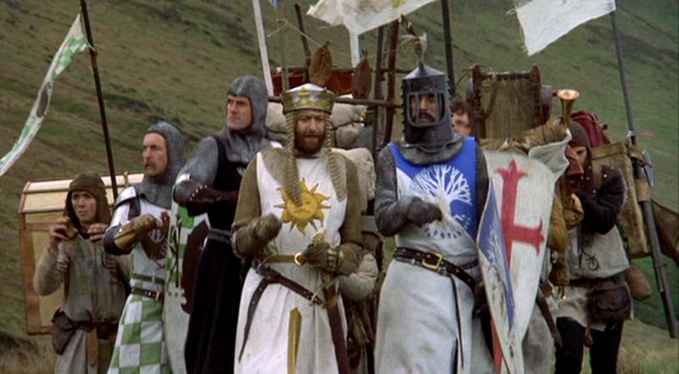
What is Python?
Python is a high-level programming language which will allow you to get a lot of work done with few lines of code.
It is supported by many modern operating systems (Windows, Mac, Linux, Android, iOS, etc.)
Since it is an interpreted language, there is no need to compile your code, as you would in C/C++/Java/etc.
Surprisingly, Python is named not after the snake, but rather after the comedy troupe Monty Python

Slide 5

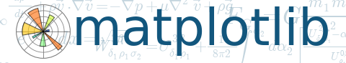
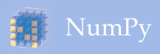
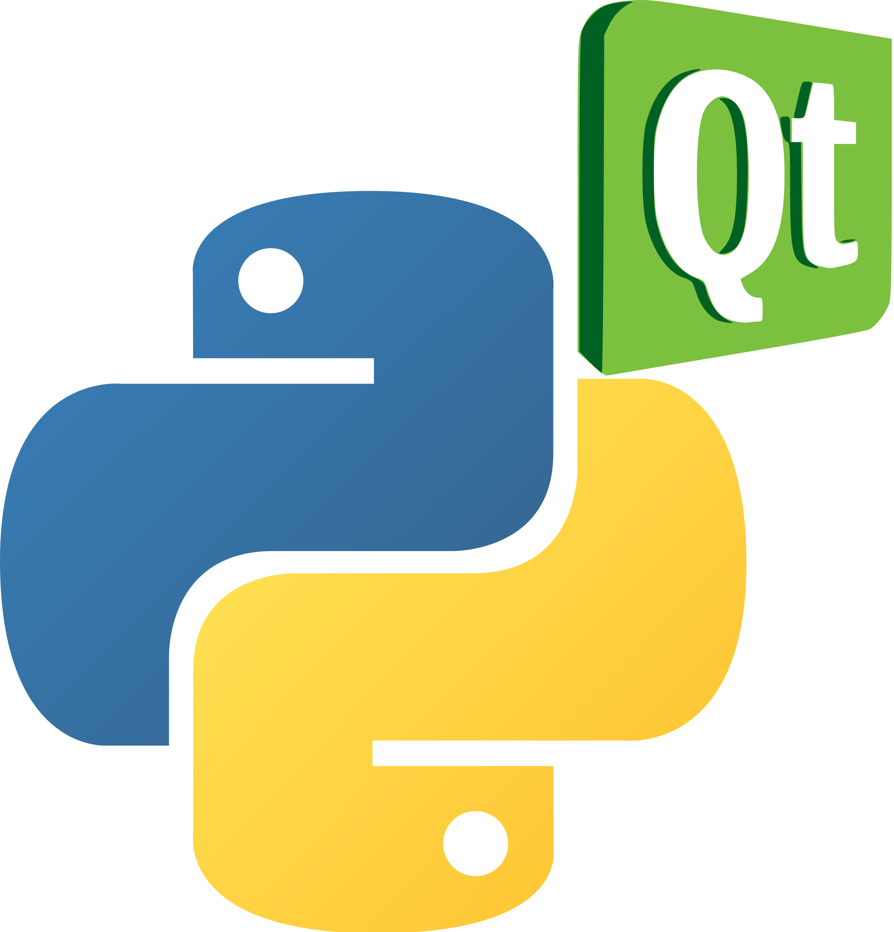

Why use Python?
Because it is supported by so many platforms, your code will not be limited to just your machine, or even just your operating system!
It’s free!!
There is already massive support for python in the form of third-party libraries. These will help you do things like:
Develop a game using PyGame
Make really cool plots for your conference paper using matplotlib
Build a graphical user interface (GUI) using PyQt
Scientific computing using NumPy
Web development using Django
The list goes on…
Python’s flexibility allows you to be massively productive without writing too many lines of code.
Python bindings are available for many popular APIs: Google services, Amazon AWS, etc.

Slide 6
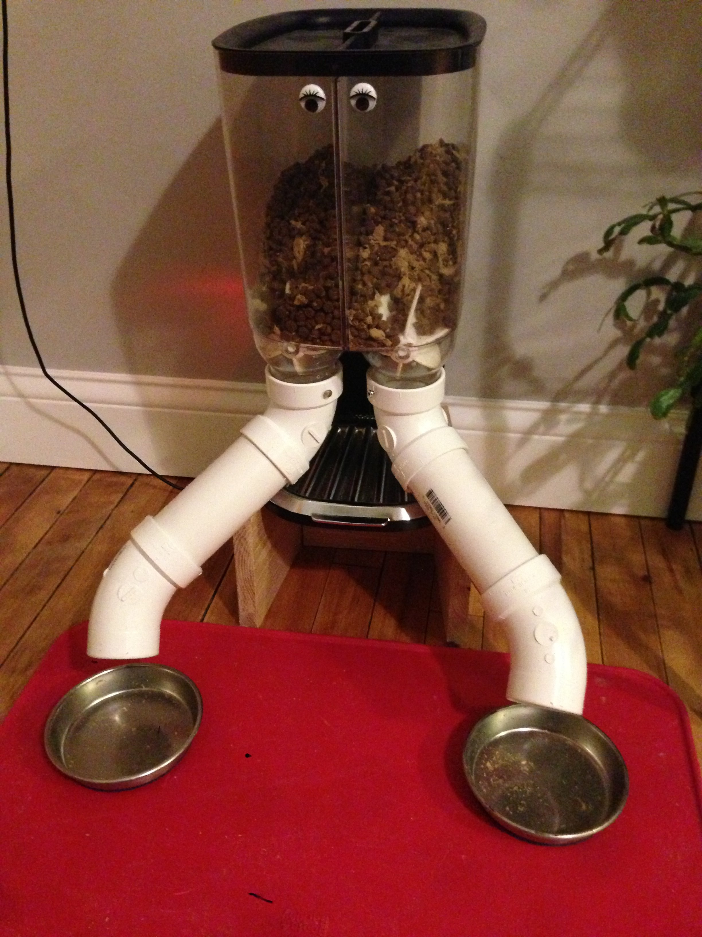
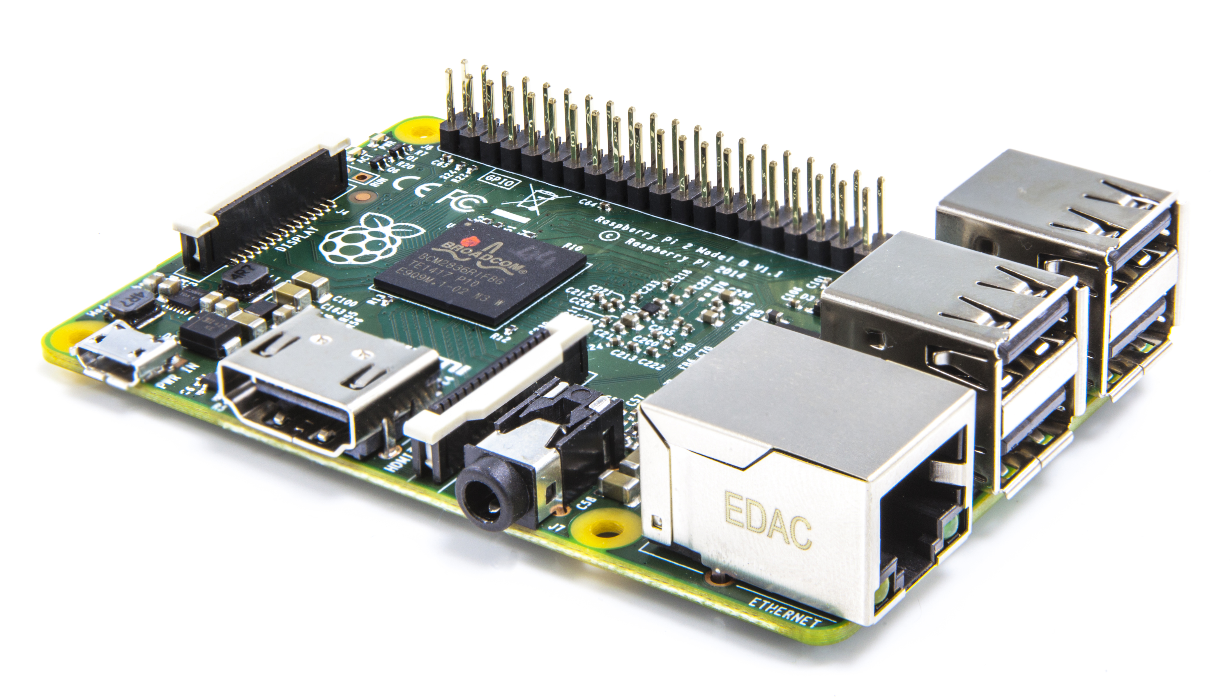
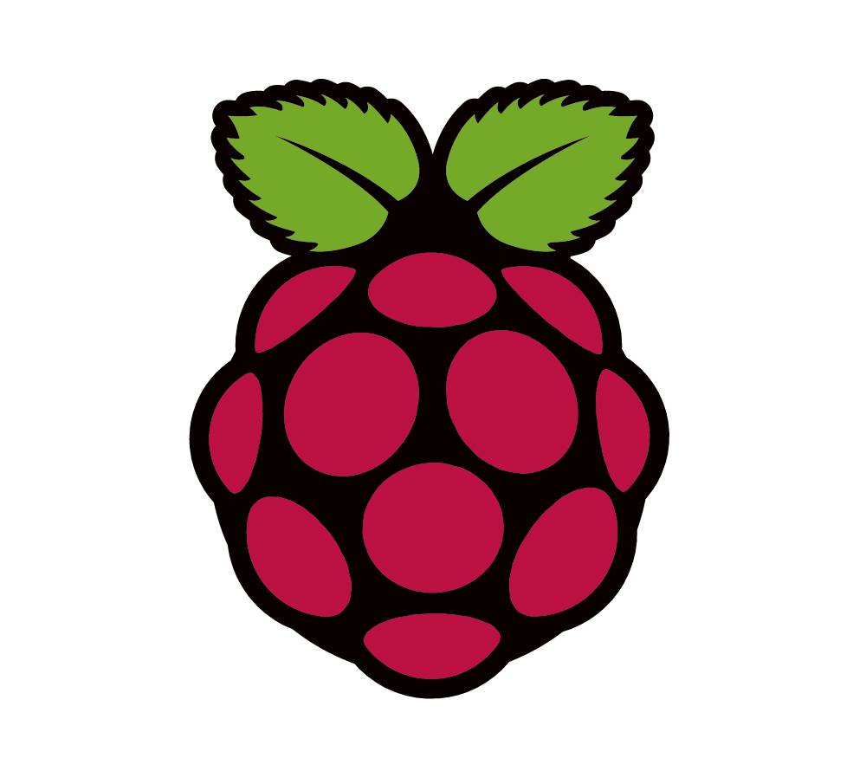
Raspberry Pi
The Raspberry Pi is a small, cheap single-board computer. It is ARM-based, runs Linux, and uses Python as the default programming language.
For example, this awesome cat feeder.

Slide 7
Two branches
v2.x (current as of July 2015 is 2.7.10)
Considered as legacy
Still the default for many OS – many people still use this one!
v3.x (current as of July 2015 is 3.4.3)
Considered as the current version
Changelog here: https://docs.python.org/3/whatsnew/3.0.html
The code in this class is intended to run on v2.7.10
More on the difference between the two branches here:
https://wiki.python.org/moin/Python2orPython3

Slide 8
Before we start
Hopefully, by this point, everyone has installed Python on their laptop.
I highly recommend that you type alongside me during this course. I think you’ll get more out of it that way!
If you want to learn more, there are some really great lectures online.
Jessica McKellar @ PyCon 2014
Series from Google Developers (2 days)
If anyone does not have Python installed at this point, please try one of these:
Go ahead and install from python.org.
If, for whatever reason, you cannot install Python (perhaps because of access privileges or some other such thing), please use a web-based Python interpreter for this class: Coding Ground.
As a last resort, use this one: repl.it. It has a nice UI but supports Python 3 instead of 2.

Slide 9
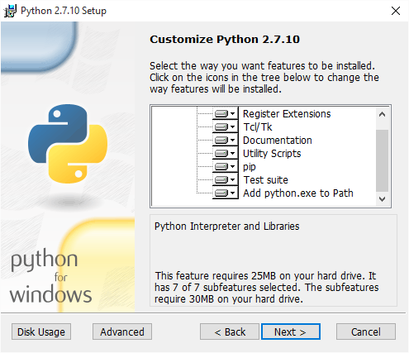
Add to path
When installing Python in Windows, I recommend enabling “Add python.exe to Path”.
This will enable you to call Python from any directory.
# if not added to path C:\scripts>C:\Python27\python.exe # if added to path C:\scripts>python

Slide 10
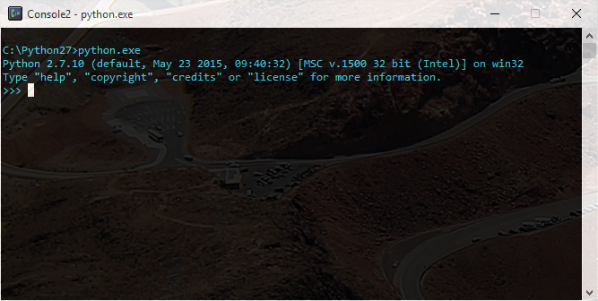
Python Interpreter
Python is a program itself. Usually we pass it files (scripts) that we have written.
Instead, let’s open the interpreter directly and have a look around.

Slide 11
Python as a calculator

Slide 12
Python as a calculator
Need to quickly calculate something? Python is a great choice. All of the mathematical operations you expect are built right in.
>>> 5 + 3 8 >>> 5.0 + 3.0 8.0 >>> 10 * 3 30 >>> 20 - 5 - 3 12
>>> x = 5 >>> x -= 3 # same as x = x - 3 >>> print x 2 >>> x += 8 # same as x = x + 8 >>> print x 10 >>> x *= 3 # same as x = x * 3 >>> print x 30

Slide 13
Python as a calculator: division
One thing to be careful with is division. Integers and floating point numbers are handled differently for division. If you divide an integer by an integer, Python expects the result to also be an integer, which may not be what you expect.
# division between two integers >>> x = 10 # int >>> y = 3 # int >>> x / y 3 # potential pitfall >>> score = 78 >>> pct = score / 100 >>> print pct 0
# division between two floats >>> x = 10.0 # float >>> y = 3.0 # float >>> x / y 3.3333333333333335 # division between float and int >>> pi = 3.14159 >>> pi / 2 1.570795

Slide 14
Basics

Slide 15
Variables
Variables let you keep track of things while programming. Without them, everything would be chaotic! Python is very forgiving with variables, which is one of the reasons it is so easy to code in. You don’t need to declare a variable or its type. Python will figure it out for you.
>>> a = "wall-e" >>> print a wall-e >>> a = 10 >>> print a 10 >>> b = True >>> print b True
>>> score0 = 73.3 >>> score1 = 92.5 >>> mean = (score0 + score1) / 2 >>> print mean 82.9 >>> hi_score = max(score0, score1) >>> print hi_score 92.5

Slide 16
Variables: naming rules
Remember that variables are case-sensitive!
Your variable name must start with a letter or underscore (_).
The remainder of your variable name may contain: letters, numbers and underscores.
A few keywords are reserved for Python. You can’t use these as variable names.
¯\_(ツ)_/¯
Valid | Invalid
_user001 | 001_user
temp_kelvin | temp-kelvin
x | 7x
true | True
userName | user#tag
MrBurns | MrBurns Bah

Slide 17
Types
There are many others, but this course will be focusing on the integer (int), floating point (float), string (str) and boolean (bool) data types. You can check the type of any variable in python using the type() function, as below.
>>> type(5) <type 'int'> >>> type(3.14) <type 'float'> >>> type("hello") <type 'str'>
>>> type('world') <type 'str'> >>> type(True) <type 'bool'> >>> type(False) <type 'bool'>

Slide 18
Typecasting
As with other programming languages, variables in python can be cast between different types. In some cases, this will result in truncation.
Some types cannot be cast between. For example, float(“cat”) will return an error.
>>> float(5) 5.0 >>> int(3.14) 3 >>> int(3.9999999) 3 >>> str(5) '5'
>>> str(3.14) '3.14' >>> int("100") 100 >>> float("cat") Traceback (most recent call last): File "<stdin>", line 1, in <module> ValueError: could not convert string to float: cat

Slide 19
Built-in functions
Python has many built-in functions. These are functions that can be called from anywhere in your program, without including any additional libraries. You can find a full list of built-in functions here: https://docs.python.org/2/library/functions.html.
We will be focusing on just a few. Remember these are case sensitive!
Function | Description | Category
id() | Determine memory location of object | Informational
input() | Query user for input | Interaction with user
int() | Convert input to int | Typecasting
float() | Convert input to float | Typecasting
len() | Determine the length of a list/string/etc. | Tool
print() | Print something to the user | Interaction with user
range() | Returns a list of integers | Tool
str() | Convert input to string | Typecasting
type() | Determine type of object | Informational

Slide 20
Indexing
Python uses 0-based indexing. This practice is common to many (if not most) programming languages.
This means that the first entry of a list, or the first character of a string, will have the index 0 instead of the index 1.
>>> name = 'Zoidberg' >>> print name[0] Z >>> print name[1] o >>> print name[7] g
>>> stocks = ['TSLA', 'FB', 'NFLX'] >>> print stocks[0] TSLA >>> print stocks[1] FB >>> print stocks[2] NFLX

Slide 21
Control flow – range()
The range() function is used to generate a list of integers. This function is used quite often in for loops, as we will see shortly. range(x) creates the list [0, 1, …, x-2, x-1]. It does not contain x!
Syntax is: range([start], stop, [step]) – both start and step are optional. Range requires only stop.
If start is omitted, it will default to 0.
If step is omitted, it will default to +1.
>>> range(5) [0, 1, 2, 3, 4] >>> range(0, 5) [0, 1, 2, 3, 4] >>> range(0, 5, 2) [0, 2, 4]
>>> range(-2, 5) [-2, -1, 0, 1, 2, 3, 4] >>> range(0, -5) [] >>> range(0, -5, -1) [0, -1, -2, -3, -4]

Slide 22
Control flow – if
If allows for code branching. Enter the if loop if the condition is true, otherwise fall back to any trailing elif (else if) branches. There may be multiple elif and a single else for any if.
# age.py age = input("enter your age: ") if age < 15: print “y0 d00dz!" elif age < 30: print "Hey!“ elif age < 45: print “Good day, sir!” else: print “Salutations!“ # ------------------------------- > age.py enter your age: 12 y0 d00dz!

Slide 23
Containment
A powerful feature of Python is the “in” operator. This will allow you to check if an item is contained in a list or dictionary; or if a character is contained in a string. You can also use “not in” to negate the containment.
>>> "y" in "python" True >>> "x" in "python" False >>> 5 in [1, 3, 5, 7] True >>> 2 not in [1, 3, 5, 7] True >>> "salt" not in ["salt", "pepper"] False

Slide 24
Control flow – for
The for loop allows you to iterate over a set of items.
It is commonly used with the “in” containment operator and a list of items.
The user specifies an iterating variable which is used inside the for loop.
The range() function is very useful in conjunction with for, as can be seen in the example.
# print students in a class >>> students = ["Al", "Bob", "Carl"] >>> for student in students: ... print student ... Al Bob Carl
# compute sum of numbers 1-10 >>> sum = 0 >>> for x in range(1, 11): ... sum += x ... >>> print sum 55

Slide 25
Control flow – others
While loop – loop which will continue indefinitely until some condition forces an exit.
Continue – continue with next iteration of loop without completing current iteration.
Break – breaks out of the smallest enclosing for or while loop.
>>> x = 0 >>> while x < 5: ... x += 1 ... print x 1 2 3 4 5
>>> for x in range(0, 100, 5): ... if x > 10: ... continue ... print x 0 5 10
>>> for x in range(0, 100, 5): ... print x ... if x > 15: ... break 0 5 10 15 20

Slide 26
Python scripts
At this point, everyone has graduated from the interpreter! Congratulations are in order.
We will be switching to writing Python files (scripts). Your favorite editor will be just fine.
The extension for Python is py.
To run your script, pass it to the python interpreter using the command line.
Command line
C:\>python.exe Hello.py

Slide 27
Hello World
Let’s try our first Python script, which will print “Hello World” to the user.
Run program from the terminal.
HelloWorld.py
#!/usr/bin/env python print “Hello World”
> python HelloWorld.py Hello World

Slide 28
The shebang (#!)
This first line of code is called a shebang.
You can choose to not include it if you wish!
In Linux, it will allow you to execute the program without having to explicitly tell Linux to call Python.
In Windows you have to do that anyway, so the shebang doesn’t help much.
From here on out, we will omit it from our code. Know that you can always add it if you wish.
HelloWorld.py
#!/usr/bin/env python print “Hello World”

Slide 29
Functions

Slide 30
Functions
If there’s something you want to do more than once, a function will be useful. There are three things to pay attention to when it comes to functions:
Function definition: this is the name of the function. The function below is named func.
Input(s): a function may have zero or more inputs. The input to func is a.
Return: a function may return one object to the caller. func returns object b.
def func(a): b = 2 * a return b

Slide 31
Functions
Once a function is defined, it can be used by the rest of your program!
The code snippet below calls the function func twice, with inputs 10 and 20.
func(10) will return 20. This is assigned to the variable x and printed.
func(20) will return 40. This is assigned to the variable y and printed.
def func(a): b = 2 * a return b x = func(10) y = func(20) print x print y

Slide 32
Function: example
Our first function is a simple one. It will query the user for a number, and then return the square of that number.
Squarify.py
def square(num_in): return num_in ** 2 x = input("enter a number: ") print square(x)
> python Squarify.py enter a number: 50 2500

Slide 33
Function: example
A function need not return anything. In this example, we just need the function to print something to the user.
Greetings.py
def greeting(F, L): print "Hello " + F + " " + L + "!" first = raw_input("first name: ") last = raw_input("last name: ") greeting(first, last)
> python Greetings.py first name: James last name: Bond Hello James Bond!

Slide 34
Function: example
A function may have as many inputs as you like. The Pythag function has two inputs (two sides of a right triangle).
A function could also have no inputs!
Pythag.py
import math def pythag(a, b): c = math.sqrt(a ** 2 + b ** 2) return c side_a = input("enter side a: ") side_b = input("enter side b: ") side_c = pythag(side_a, side_b) print "side c is: " + str(side_c)
> python Pythag.py enter side a: 3 enter side b: 4 side c is: 5.0

Slide 35
Exercises (1/2)

Slide 36
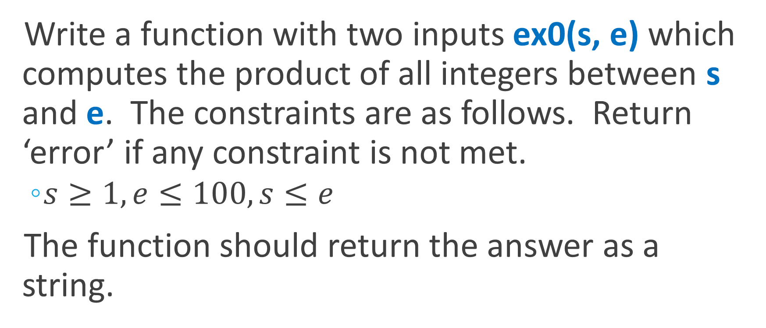
Exercise 1
Write a function with two inputs ex0(s, e) which computes the product of all integers between s and e. The constraints are as follows. Return ‘error’ if any constraint is not met.
$s≥1, e≤100, s≤e$
The function should return the answer as a string.

Slide 37
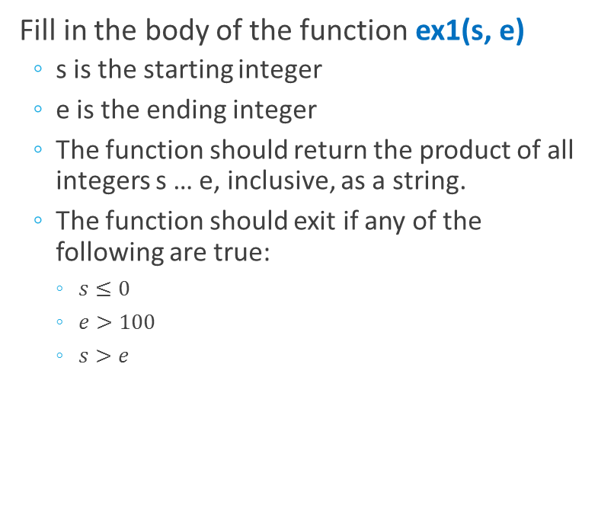
Exercise 1
Fill in the body of the function ex1(s, e)
s is the starting integer
e is the ending integer
The function should return the product of all integers s … e, inclusive, as a string.
The function should exit if any of the following are true:
$s≤0$
$e>100$
$s>e$
Exercise1.py
def ex1(s, e): # # code goes here ! # # s = input('start: ') e = input(' end: ') print 'range product: ' + ex1(s, e)

Slide 38
Exercise 1
Exercise1.py
> python Exercise1.py start: 1 end: 10 range product: 3628800 > python Exercise1.py start: 20 end: 30 range product: 2180547008640000
def ex1(s, e): if s <= 0 or e > 100 or s > e: print ‘constraints: s>0, e<=100, s<e' return 'error!' product = 1 for i in range(s, e + 1): product *= i return str(product) s = input('start: ') e = input(' end: ') print 'range product: ' + ex1(s, e)

Slide 39
Exercise 2
Write a function with one input ex2(word) where word can be any string.
This function should print the number of vowels in the word. It does not need to return anything.
Hint: use the containment operator to help find vowels.

Slide 40
Exercise 2
Remember that the function ex2(word) should compute the number of vowels in word, and print this to the user.
No return is necessary.
Exercise2.py
def ex2(word): # # code goes here ! # # ex2(raw_input('enter a word: '))

Slide 41
Exercise 2
Exercise2.py
> python Exercise2.py enter a word: cactus cactus has 2 vowels > python Exercise2.py enter a word: aerospace engineering aerospace engineering has 10 vowels
def ex2(word): vowels = 0 for letter in word.lower(): if letter in 'aeiou': vowels += 1 print word + ' has ' + str(vowels) + \ ' vowels' ex2(raw_input('enter a word: '))

Slide 42
Data Structures

Slide 43
Data Structures
Data structures are methods of organizing data within a programming language. Each data structure has benefits and drawbacks. Many are beyond the scope of this course. We will be focusing on the python list (array) and dictionary (hashmap).
Some examples of data structures are shown below. We will not focus on either tree or linked list, but they are useful to show visually how the data structures differ.
tree
list (array)
linked list
dictionary

Slide 44
List
The most common data structure in Python is a comma-separated list of items. A list is contained within square brackets.
Lists can be indexed, assigned or sliced using notation similar to MATLAB (although zero-based).
employees = [“Fry”, “Bender”, “Zoidberg”, “Leela”] test_scores = [93.5, 88.3, 91.6] a = [] # empty list teams = [[“Emily”, “Will”], [“Chris”, “Dan”]] # nested Student = [“Jon”, 15, 97.9, True] # heterogeneous!

Slide 45
List – accessing and modifying
Lists can be accessed and modified in python using square brackets.
Similar to many other programming languages, indexing in python begins with 0.
Negative indices can be used to access a list beginning with the last element.
The index used must be within the list. In the below examples, accessing a[5] will return an error.
>>> a = [5, 3, -2, 7, 0] >>> print a[0] 5 >>> print a[2] -2 >>> print a[-1] 0
>>> a = [5, 3, -2, 7, 0] >>> a[0] = 100 >>> print a [100, 3, -2, 7, 0] >>> a[-1] = 200 >>> print a [100, 3, -2, 7, 200]

Slide 46
List – slicing
To access multiple elements simultaneously, the list can be sliced, also using square brackets.
Slicing can also be used to split a list into two parts, or to make a copy of a list.
As with the range() function, a[m:n] will contain a[m], a[m+1], …, a[n-1] but not a[n]
If the first argument is omitted, it defaults to 0.
If the second argument is omitted, it defaults to the length of the list.
>>> a = [5, 3, -2, 7, 0] >>> print a[1:3] [3, -2] >>> print a[2:] [-2, 7, 0] >>> print a[:2] [5, 3]
>>> a = [5, 3, -2, 7, 0] >>> left = a[:3] >>> right = a[3:] >>> print left, right [5, 3, -2], [7, 0]

Slide 47
List – slice to copy
The slice operator without any bounds will create a copy of the original list.
# slicing makes a copy >>> a = [5, 3, -2, 7, 0] >>> b = a[:] >>> print a [5, 3, -2, 7, 0] >>> print b [5, 3, -2, 7, 0] >>> b[0] = 6 >>> print b [6, 3, -2, 7, 0] >>> print a [5, 3, -2, 7, 0]
# here, a and b point to the same object >>> a = [5, 3, -2, 7, 0] >>> b = a >>> print a [5, 3, -2, 7, 0] >>> print b [5, 3, -2, 7, 0] >>> b[0] = 6 >>> print b [6, 3, -2, 7, 0] >>> print a [6, 3, -2, 7, 0]

Slide 48
List – routines
Lists have a number of useful methods. A method is a function which can be called on any list object. For a complete listing of list’s methods, please see this page: https://docs.python.org/2/tutorial/datastructures.html#more-on-lists.
Syntax for calling method sort() on object x is: x.sort()
For us, it is enough to focus on a few methods:
append(x) – add a single item to the end of the list.
extend(x) – add all the elements in list x to the end of the list.
sort() – sort the list (defaults to ascending order).
reverse() – reverse the order of the list’s elements.
>>> a = [5, 3, -2, 7, 0] >>> a.sort() >>> print a [-2, 0, 3, 5, 7] >>> a.reverse() >>> print a [7, 5, 3, 0, -2]

Slide 49
List – append()
List’s append(x) routine will add x to the end of the list. This gets used quite often.
In the example on the right, we use append to keep track of all scores above a certain cutoff.
HighScores.py
def filter(s, c): hi_scores = [] for score in s: if score >= c: hi_scores.append(score) return hi_scores scores = [75, 80, 93, 60, 72, 74] cutoff = 75 print filter(scores, cutoff)
> python HighScores.py [75, 80, 93]

Slide 50
List – extend()
The extend routine accepts a list as its input. All of the elements in the input list will be added to the end of the called object’s list.
For lists a and b, a.extend(b) is equivalent to a concatenation between the lists.
>>> a = [1, 3, 5, 7] >>> b = [2, 4, 6] >>> a.extend(b) >>> print a [1, 3, 5, 7, 2, 4, 6] >>> b.extend(a) >>> print b [2, 4, 6, 1, 3, 5, 7, 2, 4, 6]

Slide 51
Dictionary
Also known as a hash table or hash map, the dictionary stores a set of key/value pairs.
Use curly braces “{ }” for dictionaries. When you are initializing a dictionary, use comma separated pairs of objects. For example, {"a":"b", "c":"d"} will create the dictionary below.

Slide 52
Dictionary – keys and values
There is a lot of detail on what can be used as a key. It has to do with mutability, and I’ll get to it if there’s time at the end. If not, there are some backup slides on it. This description on python.org of why strings are immutable is useful to help understanding: https://docs.python.org/2/faq/design.html#why-are-python-strings-immutable.
For this course, we can restrict ourselves to the following:
The keys may be any immutable type, but for now just know to use: numbers and strings as keys.
Mutable types may not be used as keys. This means the key cannot be a list or dictionary!
Values can be any type.
Types allowed as key:
int
float
string
list
dict

Slide 53
Dictionary – interaction
Interacting with a dictionary is very similar to interacting with a list.
With a list, the index had to be an integer, starting with 0.
In a dictionary, the index is the key, and the key can be any of the types we just discussed.
The value can be whatever we want. It can even be a list or another dictionary!
>>> d = {"a":27, "b":"dog"} >>> print d {'a': 27, 'b': 'dog'} >>> d["c"] = [1, 3] # add key "c" >>> print d {'a': 27, 'c': [1, 3], 'b': 'dog'}
>>> print len(d) 3 >>> del d["a"] # remove key "a" >>> print d, len(d) {'c': [1, 3], 'b': 'dog'} 2

Slide 54
Dictionary
Using a dictionary is a really easy way to deal with objects and their properties. In this example, we are storing unencrypted passwords for three users.
>>> pwords = {"coolGuy0" : "the", "h4xor" : "12345", "bGates" : "$$$$$$"} # create a dictionary called pwords >>> print pwords # print the dictionary {'bGates': '$$$$$$', 'coolGuy0': 'the', 'h4xor': '12345'} >>> print pwords["bGates"] # print a value $$$$$$ >>> pwords["h4xor"] = "54321“ # change a value >>> print pwords # print the new dictionary {'bGates': '$$$$$$', 'coolGuy0': 'the', 'h4xor': '54321'}

Slide 55
Dictionary – example 1
A dictionary is a great way to count unique elements.
In this example we are keeping track of how many times each grade was observed.
Repeats.py
def Repeats(grades): D = {} for g in grades: if g in D: D[g] += 1 else: D[g] = 1 return D grades = ["A", "A+", "B", "B", "A", "C"] rep = Repeats(grades) for grade in rep: print grade + ": " + str(rep[grade])
> python Repeats.py A: 2 A+: 1 B: 2 C: 1

Slide 56
Dictionary – example 2
Keep track of user’s ages
AgeList.py
> python AgeList.py enter name: bob enter age: 30 enter name: bob enter age: 35 enter name: jill enter age: 32 bob->[30, 35] jill->[32]
D = {} for person in range(3): name = raw_input("enter name: ") age = int(raw_input("enter age: ")) if name in D: D[name].append(age) else: D[name] = [age] print "" for person in D: print d + "->" + str(D[d])

Slide 57
Dictionary – example 3
A very simple game involving the player and an enemy.
Dictionary is used to keep track of each character’s attributes.
Game.py
# set up characters player = {'health': 50, 'damage': 300, 'armor': []} enemy = {'health': 250, 'damage': 200, 'armor': ['Laser Armor']} # consume armor for armor in enemy['armor']: enemy['health'] += 25 for armor in player['armor']: player['health'] += 25 # fight! if player['damage'] > enemy['health']: print "player wins!" elif enemy['damage'] > player['health']: print "player loses!" else: print "stalemate!"
> python Game.py player wins!

Slide 58
Importing libraries

Slide 59
Libraries
Widespread Python support means a rich selection of third-party libraries for multiple platforms.
This means you can spend less time reinventing the wheel.
Import a library into your script using the import keyword.
>>> import math >>> p = math.pi >>> r = 10 >>> print p * math.pow(r, 2) 314.159265359 >>> print 2 * p * r 62.8318530718
>>> import random >>> print random.randrange(10) 4 >>> print random.randrange(10) 9 >>> print random.randrange(10) 5

Slide 60
Python standard library
There are a large number of libraries that are included by default in your Python distribution. These are collectively known as the Python standard library. There are many, and of course you don’t have to memorize them all. If you’re curious, see here: https://docs.python.org/2/library/.
We just saw two of them! math and random are both included in the Python standard library.
Since they are included by default, you do not need to install these libraries.

Slide 61
Practical Example 1
Image Processing

Slide 62
Image processing
We can take advantage of the Pillow library to make image processing a breeze.
This short program will let us smooth out an image a specified amount.
MedianFilterA.py
from PIL import Image from PIL import ImageFilter im = Image.open(“nature.jpg") # load image s = int(raw_input("enter smoothness: ")) if s < 0 or s > 10: # make sure input is reasonable print "smoothness must be in range [0, 10]" exit() for i in range(s): print "processing: " + str(i + 1) + " of " + str(s) im = im.filter(ImageFilter.MedianFilter(5)) print "finished" imOutName = “nature_" + str(s) + ".jpg" im.save(imOutName, "JPEG") im.show()
> python MedianFilterA.py enter smoothness: 5 processing: 1 of 5 processing: 2 of 5 processing: 3 of 5 processing: 4 of 5 processing: 5 of 5 finished!

Slide 63


Image processing

Slide 64
Image processing
We can easily modify our program to add a new feature. Now we let the user select between two different filters.
MedianFilterB.py
from PIL import Image from PIL import ImageFilter im = Image.open("nature.jpg") # load image s = int(raw_input("enter smoothness: ")) r = int(raw_input("select filter: ")) if (s < 0 or s > 10) or (r < 0 or r > 1): print "smoothness must be in range [0, 10]" print "filter should be in range [0, 1]" exit() for i in range(s): print "processing: " + str(i + 1) + " of " + str(s) if r == 0: im = im.filter(ImageFilter.MedianFilter(5)) else: im = im.filter(ImageFilter.GaussianBlur(5)) print "finished!" imOutName = "nature" + str(s) + "_" + str(r) + ".jpg" im.save(imOutName, "JPEG") im.show()
> python MedianFilterB.py enter smoothness: 5 select filter: 1 processing: 1 of 5 processing: 2 of 5 processing: 3 of 5 processing: 4 of 5 processing: 5 of 5 finished!

Slide 65

Image processing

Slide 66
Practical Example 2
Anagram detection

Slide 67
Anagram detection
This is a common interview question, and it’s really easy to solve with a few key ideas.
Once we have the ideas, it can be done in surprisingly little code.
Goal: given a word in English, find all of its anagrams.

Slide 68
Anagram detection
This is a common interview question, and it’s really easy to solve with a few key ideas.
Once we have the ideas, it can be done in surprisingly little code.
Goal: given a word in English, find all of its anagrams.
Hint: the dictionary data structure will help!
We can solve this in two steps:
Step one: process a wordlist using our key idea.
Step two: pick a word and list all its anagrams.

Slide 69
Anagram detection
Key idea:
We need a representation where any two words which are anagrams point to the same thing.
Two words which are anagrams have exactly the same letters, but in different order.
Think about sorting…

Slide 70
Anagram detection
Key idea:
We need a representation where any two words which are anagrams point to the same thing.
Two words which are anagrams have exactly the same letters, but in different order.
Think about sorting…

Slide 71
Anagram detection
Key idea:
We need a representation where any two words which are anagrams point to the same thing.
Two words which are anagrams have exactly the same letters, but in different order.
Think about sorting…
Now we can use a dictionary, where the key is the sorted string, and the value is a list of all words which have that sorted string.
Once we have built up this dictionary, using a wordlist, it’s quick and easy to find all the anagrams for any given word!

Slide 72
Anagram detection
We have the idea, now let’s put it into code!
The function gen_key converts the input string to lowercase and then sorts it.
Anagram.py
def gen_key(string_in): string_in = string_in.lower() # convert to lowercase a = list(string_in) # convert string to list return "".join(sorted(a)) # convert list to string, return D = {} print "processing word list..." with open("wlist.txt") as f: for line in f: word = line.strip() # remove whitespace, newlines k = gen_key(word) # k is the sorted string if k in D: D[k].append(word) else: D[k] = [word] print "done" word = raw_input("enter word: ") print D[gen_key(word)]
> python Anagram.py processing word list... done enter word: horse ['heros', 'horse', 'osher', 'shore']

Slide 73
Exercises (2/2)

Slide 74
Exercise 3
Write a function with two inputs, ex3(a, n) which returns the top n scores within an input list a.
The top n scores should be returned as a list.

Slide 75
Exercise 3
Hint: use list slicing!
Exercise3.py
def ex3(a, n): # # code goes here ! # # test_scores = [75, 38, 92, 15, 94, 50, 88] print ex3(test_scores, 4)

Slide 76
Exercise 3
Exercise3.py
> python Exercise3.py [75, 88, 92, 94]
def ex3(a, n): b = sorted(a) return b[-n:] test_scores = [75, 38, 92, 15, 94, 50, 88] print ex3(test_scores, 4)

Slide 77
Exercise 4
Write a function with one input, ex4(string) which counts the number of occurrences of each character within the string, and returns it as a dictionary.

Slide 78
Exercise 4
Return a dictionary with:
Each character being a key
The value associated with each key is the number of occurrences of that character
Exercise4.py
def ex4(string): # # code goes here ! # # test_string = 'the quick brown fox jumps over the lazy dog' print ex4(test_string)

Slide 79
Exercise 4
Exercise4.py
> python Exercise4.py {' ': 8, 'a': 1, 'c': 1, 'b': 1, 'e': 3, 'd': 1, 'g': 1, 'f': 1, 'i': 1, 'h': 2, 'k': 1, 'j': 1, 'm': 1, 'l': 1, 'o': 4, 'n': 1, 'q': 1, 'p': 1, 's': 1, 'r': 2, 'u': 2, 't': 2, 'w': 1, 'v': 1, 'y': 1, 'x': 1, 'z': 1}
def ex4(string): string = string.lower() result = {} for letter in string: if letter in result: result[letter] += 1 else: result[letter] = 1 return result test_string = 'the quick brown fox jumps over the lazy dog' print ex4(test_string)

Slide 80
Thanks!

Slide 81
Acknowledgments
This class took a lot of time and effort to put together. I didn’t do it alone. I really appreciate the help provided by the following people:
Prof. Truong Nguyen (UCSD ECE Department Chair, Professor)
Dr. Karl Ni (Lawrence Livermore National Laboratory, UCSD PhD 2008)
Please see Karl’s upcoming course “Build Your First AI Algorithm” using Python and the Keras toolbox.
Dr. Sayanan Sivaraman (Apple, UCSD PhD 2013)
Alain Domissy (---)
Trey Hunner (Teacher, SD Python co-organizer)

Slide 82
Backup

Slide 83
Mutability
If an object is mutable, then it can be changed while still pointing to the same memory location. This is great for things like lists and dictionaries. You can do almost anything to a list or dictionary, and Python is fine with it. It will allocate and de-allocate memory as needed.
This poses a problem for hashing, however. To remain fast, the hashing process should be able to compute the hash value for an object once, and be done with it. This requires that the object isn’t changing in a meaningful way.
We can get some more insight into this topic by re-opening our interpreters and using id() to find the memory location of different mutable and immutable objects.

Slide 84
Mutability
All data in Python is represented as objects. Objects are either mutable or immutable.
Immutable – The object’s identity will change if its content is changed.
Ex: int, float, string, tuple
Mutable – The object’s content can be changed without changing its identity.
Ex: list, dictionary, class
>>> s = "ucsd“ # strings are immutable >>> id(s) 37942720 >>> s += " is great" >>> id(s) 38416080 >>> print s ucsd is great
>>> s = ["rick", "morty"] # lists are mutable! >>> id(s) 38413016 >>> s.append("jerry") >>> id(s) 38413016 >>> print s ['rick', 'morty', 'jerry']

Slide 85
Tuple
Similar to a list, a tuple is also a collection of items. However, a tuple is immutable while a list is mutable. While you lose flexibility in using a tuple, you gain speed in exchange. Operations with tuples will take less time to compute. You cannot modify an element in a tuple.
Tuples are defined using a comma-separated collection of values in parens “( )”.
>>> x = (3, 5) >>> print x[0] 3 >>> x[0] = 5 Traceback (most recent call last): File "<stdin>", line 1, in <module> TypeError: 'tuple' object does not support item assignment
>>> x = (1, 2) >>> y = (3, 4) >>> x + y (1, 2, 3, 4) >>> len(x) 2 >>> len(x + x + y) 6

Slide 86
Classes

Slide 87
Classes
The class is fundamental to any object-oriented programming language.
Technically speaking, a class is a template for creating objects. The power behind classes is that the programmer gets to define all the parameters of the template. This is done using member variables and member methods (functions). Any number of these may be defined for your class.
class MyClass: x = 500 type = 'helicopter' def get_type(self): return type

Slide 88
The Constructor
The constructor is used to initialize the object of class type when it is created.
For example, in the below MyPlayer class, the constructor is defined as __init__(self, H)
The self keyword refers to the instance of the object and is used to store values which belong only to a specific instance of the class. On the other hand, all instances of the MyPlayer class share the game variable.
The variable x will point to an instance of the MyPlayer class. This instance will have a “health” attribute of 100, and a “powerups” attribute of 0.
class MyPlayer: game = 'Mortal Wombat' def __init__(self, H): self.health = H self.powerups = 0 x = MyPlayer(100)

Slide 89
Classes – creation and scope
In this example, we have two players. Each player is an object of type MyPlayer.
The two players are initialized with different amounts of health. From within the class, health is referenced as self.health
From outside the class, health is an attribute of the object. For example, left_player.health
class MyPlayer: game = 'Mortal Wombat' def __init__(self, H): self.health = H self.p_ups = 0 def add_powerup(self): self.p_ups += 1 def print_state(self): print self.game, self.health, self.p_ups left_player = MyPlayer(100) right_player = MyPlayer(50) left_player.add_powerup() left_player.print_state() right_player.print_state()
Mortal Wombat 100 1 Mortal Wombat 50 0

Slide 90
Classes – example
In the example before, we used dictionaries to store player attributes. Of course, it makes more sense to do this using classes.
Most games rely heavily on class structure.
BetterGame.py
class Character: def __init__(self, h, d): self.health = h self.damage = d self.armor = [] def add_armor(self, armor): self.armor.append(armor) def attack(self, enemy): for armor in self.armor: self.health += 25 for armor in enemy.armor: enemy.health += 25 if self.damage > enemy.health: print 'Player wins' elif enemy.damage > self.health: print 'Player loses' else: print 'Stalemate!' player = Character(50, 300) enemy = Character(250, 200) enemy.add_armor('Laser Armor') player.attack(enemy) # fight!
>python BetterGame.py Player wins

